Slide 1
Final Project
System Administration
Jadah Castillo

Slide 2
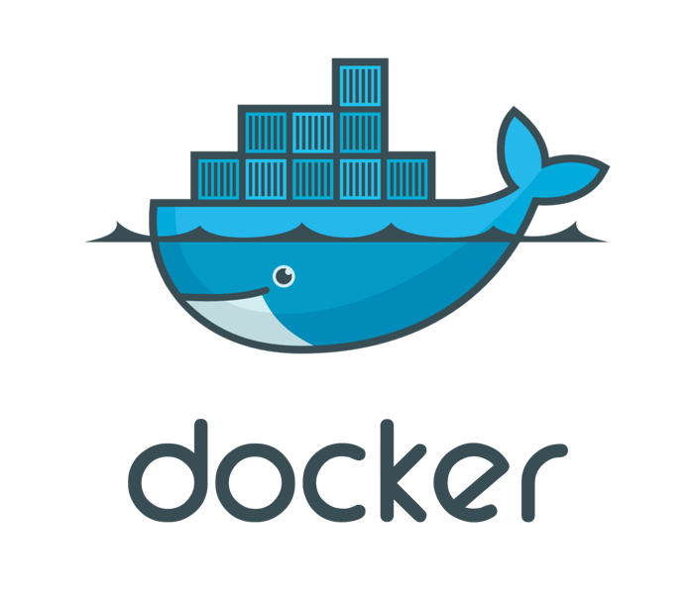
What is Docker?
Open Platform
Containers
It is useful for:
Fast, consistent delivery of your applications
Responsive deployment and scaling
Running more workloads on the same hardware

Slide 3
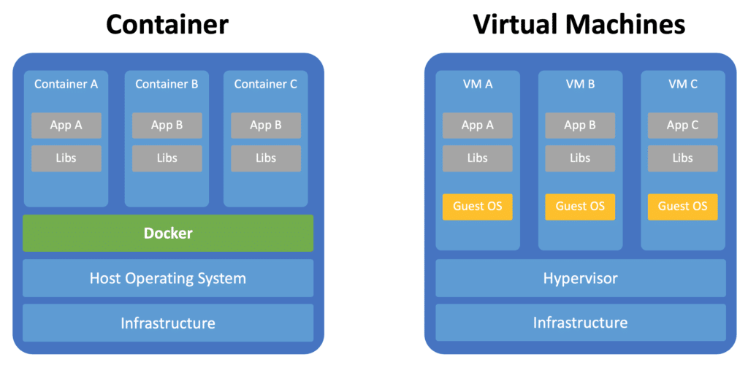
Container

Slide 4
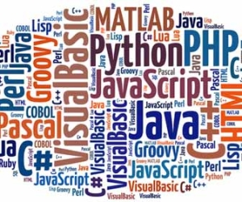
Web App
Tools Used:
HTML
GO
CSS
Mavo
JS
JSON
Docker

Slide 5
Demonstration

Slide 6
Conclusion
Challenges with this project
What I learned from this
What I wished to see from this project

